Slide 1
Demystifying Contrastive Self-Supervised Learning: Invariances, Augmentations and Dataset Biases
Senthil Purushwalkam (CMU) Abhinav Gupta (CMU, FAIR)
Email: spurushw@cs.cmu.edu

Slide 2
Self-supervised Learning: Definition and Goals
Definition:
An approach to learn a feature representation from data without human supervision
Goal:
Learn a good feature extractor or an initialization that is useful for a wide range of tasks or a specific task that you care about
$$θ$$
Feature
$$θ$$
Loss
Function
ImageNet
$$θ$$
Dog!
$θ$’
Dog!

Slide 3
The Era of Designing Pretext Tasks
200x - 2019
Compression
Completion
Clustering
Compressed data representations that allow reconstruction of the data
Hide a part of the data, learn to predict it using the non-hidden part
Learn a representation that clusters according to a hand-crafted constraint
Vincent, Pascal, et al. "Extracting and composing robust features with denoising autoencoders." Proceedings of the 25th international conference on Machine learning. 2008.
Radford, Alec, Luke Metz, and Soumith Chintala. "Unsupervised representation learning with deep convolutional generative adversarial networks." arXiv preprint arXiv:1511.06434 (2015).
Zhuang, Fuzhen, et al. "Supervised representation learning: Transfer learning with deep autoencoders." Twenty-Fourth International Joint Conference on Artificial Intelligence. 2015.
Pathak, Deepak, et al. "Context encoders: Feature learning by inpainting." Proceedings of the IEEE conference on computer vision and pattern recognition. 2016.
Zhang, Richard, Phillip Isola, and Alexei A. Efros. "Colorful image colorization." European conference on computer vision. Springer, Cham, 2016.
Vondrick, Carl, Hamed Pirsiavash, and Antonio Torralba. "Generating videos with scene dynamics." Advances in neural information processing systems. 2016.
Zhao, Qilu, and Zongmin Li. "Unsupervised Representation Learning with Laplacian Pyramid Auto-encoders." arXiv preprint arXiv:1801.05278 (2018).
Zhang, Liheng, et al. "Aet vs. aed: Unsupervised representation learning by auto-encoding transformations rather than data." Proceedings of the IEEE Conference on Computer Vision and Pattern Recognition. 2019.
Doersch, Carl, Abhinav Gupta, and Alexei A. Efros. "Unsupervised visual representation learning by context prediction." Proceedings of the IEEE International Conference on Computer Vision. 2015.
Agrawal, Pulkit, Joao Carreira, and Jitendra Malik. "Learning to see by moving." Proceedings of the IEEE international conference on computer vision. 2015.
Wang, Xiaolong, and Abhinav Gupta. "Unsupervised learning of visual representations using videos." Proceedings of the IEEE International Conference on Computer Vision. 2015.
Misra, Ishan, C. Lawrence Zitnick, and Martial Hebert. "Shuffle and learn: unsupervised learning using temporal order verification." European Conference on Computer Vision. Springer, Cham, 2016.
Noroozi, Mehdi, and Paolo Favaro. "Unsupervised learning of visual representations by solving jigsaw puzzles." European Conference on Computer Vision. Springer, Cham, 2016.
Li, Dong, et al. "Unsupervised visual representation learning by graph-based consistent constraints." European Conference on Computer Vision. Springer, Cham, 2016.
Pathak, Deepak, et al. "Learning features by watching objects move." Proceedings of the IEEE Conference on Computer Vision and Pattern Recognition. 2017.
Gidaris, Spyros, Praveer Singh, and Nikos Komodakis. "Unsupervised representation learning by predicting image rotations." arXiv preprint arXiv:1803.07728 (2018).
Wang, Xiaolong, and Abhinav Gupta. "Unsupervised learning of visual representations using videos." Proceedings of the IEEE International Conference on Computer Vision. 2015.
Jayaraman, Dinesh, and Kristen Grauman. "Learning image representations tied to ego-motion." Proceedings of the IEEE International Conference on Computer Vision. 2015.
Bojanowski, Piotr, and Armand Joulin. "Unsupervised learning by predicting noise." Proceedings of the 34th International Conference on Machine Learning-Volume 70. JMLR. org, 2017.
Yan, Xueting, et al. "ClusterFit: Improving Generalization of Visual Representations." arXiv preprint arXiv:1912.03330 (2019).
Wu, Zhirong, et al. "Unsupervised feature learning via non-parametric instance discrimination." Proceedings of the IEEE Conference on Computer Vision and Pattern Recognition. 2018.
Oord, Aaron van den, Yazhe Li, and Oriol Vinyals. "Representation learning with contrastive predictive coding." arXiv preprint arXiv:1807.03748 (2018).
He, Kaiming, et al. "Momentum contrast for unsupervised visual representation learning." arXiv preprint arXiv:1911.05722 (2019).
Misra, Ishan, and Laurens van der Maaten. "Self-supervised learning of pretext-invariant representations." arXiv preprint arXiv:1912.01991 (2019).

Slide 4
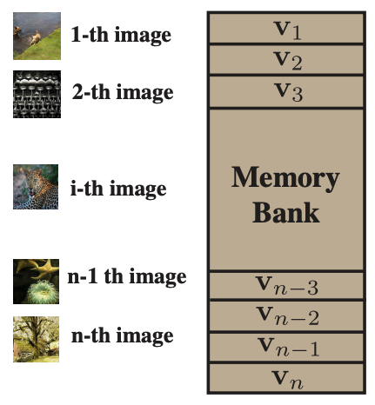
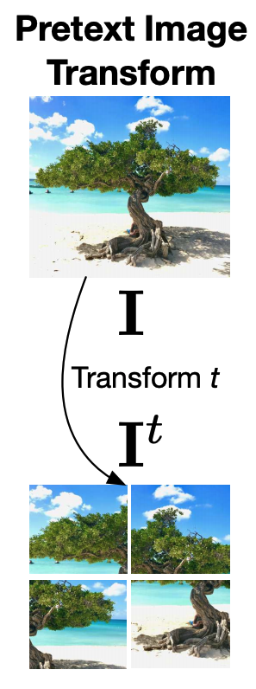
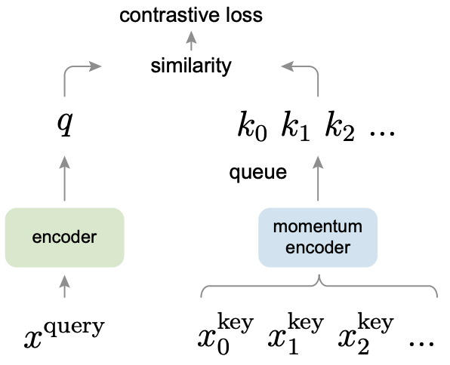
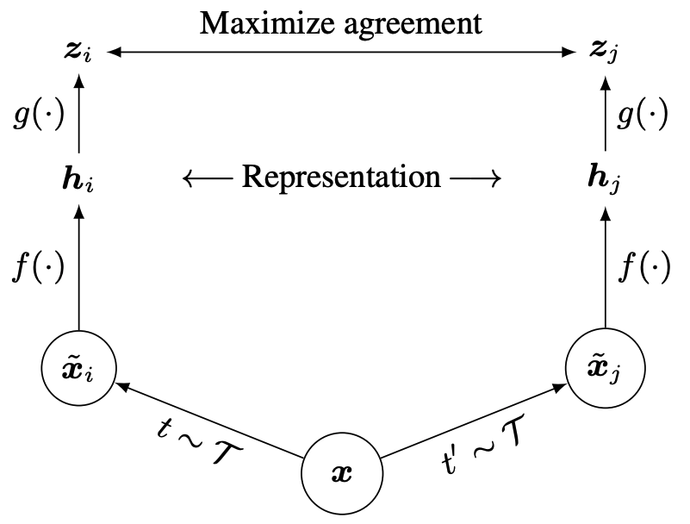
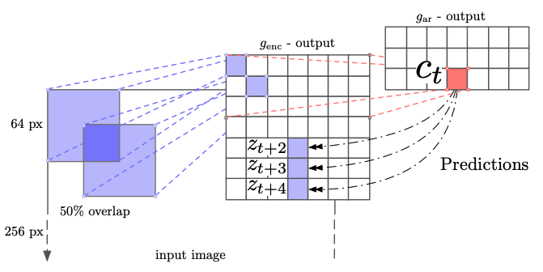
State of the art Self-Supervised Learning
CPC
NPID
PIRL
MOCO
SimCLR
Hénaff, Olivier J., et al. "Data-efficient image recognition with contrastive predictive coding." arXiv preprint arXiv:1905.09272 (2019).
Hénaff, Olivier J., et al. "Data-efficient image recognition with contrastive predictive coding." arXiv preprint arXiv:1905.09272 (2019).
Misra et al. "Self-supervised learning of pretext-invariant representations." CVPR. 2020.
He, Kaiming, et al. "Momentum contrast for unsupervised visual representation learning." CVPR. 2020.
Chen, Ting, et al. "A simple framework for contrastive learning of visual representations." arXiv preprint arXiv:2002.05709 (2020)

Slide 5
Contrastive Learning in a Nutshell
$$x, { x}^{+}$$
Positive Sample Pair
$$x_{1}^{−},x_{1}^{−},…, x_{K}^{−}$$
Negative Samples
$$L(θ)= \frac{e^{f_{θ}{\left(x\right)}^{T}f_{θ}\left(x^{+}\right)}}{e^{f_{θ}{\left(x\right)}^{T}f_{θ}\left(x^{+}\right)}+\sum_{i=0}^{K}{e^{f_{θ}{\left(x\right)}^{T}f_{θ}\left(x_{i}^{−}\right)}}}$$

Slide 6
Self-Supervised Learning via Contrastive Learning
$$x=t(x), {x^{+}=t}_{+}(x)$$
Positive Sample Pair
Negative Samples
$$x_{1}^{−}=t_{1}(x_{1}),x_{2}^{−}=t_{2}(x_{2}),…, {x_{K}^{−}=t}_{K}(x_{K})$$
$$t, t_{+},t_{1},t_{2},…,t_{K}\sim T$$
set of random transformations
$$L(θ)= \frac{e^{f_{θ}{\left(x\right)}^{T}f_{θ}\left(x^{+}\right)}}{e^{f_{θ}{\left(x\right)}^{T}f_{θ}\left(x^{+}\right)}+\sum_{i=0}^{K}{e^{f_{θ}{\left(x\right)}^{T}f_{θ}\left(x_{i}^{−}\right)}}}$$
Instance Classification Objective

Slide 7
Self-Supervised Learning via Contrastive Learning
$$x=t(x), {x^{+}=t}_{+}(x)$$
Positive Sample Pair
Negative Samples
$$x_{1}^{−}=t_{1}(x_{1}),x_{2}^{−}=t_{2}(x_{2}),…, {x_{K}^{−}=t}_{K}(x_{K})$$
$$t, t_{+},t_{1},t_{2},…,t_{K}\sim T$$
set of random transformations
$$L(θ)= \frac{e^{f_{θ}{\left(x\right)}^{T}f_{θ}\left(x^{+}\right)}}{e^{f_{θ}{\left(x\right)}^{T}f_{θ}\left(x^{+}\right)}+\sum_{i=0}^{K}{e^{f_{θ}{\left(x\right)}^{T}f_{θ}\left(x_{i}^{−}\right)}}}$$
Instance Classification Objective

Slide 8
MOCO
PIRL
$$T$$
$$T$$
$$t_{+}$$
Crop 20%-100%
Color Jitter with p=0.8
Grayscale with p=0.2
Gaussian Blur with p=0.5
Horizontal Flip with p=0.2
Crop 20%-100% of the original image
Color Jitter with probability p=0.8
Grayscale with probability p=0.2
Gaussian Blur with probability p=0.5
Random Horizontal Flip with p=0.2
Crop 60%-100%
Split into 3 X 3 grid uniformly
Apply $t$~T to each patch

Slide 9
Evaluating Invariances and not Task Metrics

Slide 10
The Standard Quantitative Evaluation
Linear ImageNet Classification
Object Detection
$$θ$$
…. Keypoint Estimation, Semantic Segmentation, Pose Estimation
Dog!
$$θ$$
Train weights
Train weights

Slide 11
The Standard Quantitative Evaluation
Why are PIRL and MoCo better than an ImageNet trained model?
Why does MoCo outperform PIRL?
What other kinds of domains/tasks would PIRL be better at?
Is there a pattern in the failure cases of the ImageNet model where MoCo or PIRL succeed?
Object Detection Results on VOC07+12 taken from [1]
Method AP^{all} PIRL 54.0 MoCo 55.2 ImageNet Supervised 52.6
1. Misra et al. "Self-supervised learning of pretext-invariant representations." CVPR. 2020.

Slide 12
Invariances
$$x$$
$$G(x)$$
$$θ$$
$$θ$$
$$=$$
$$f_{θ}(x)$$
$$f_{θ}(G(x))$$
$f_{θ}$ is invariant to the transformation $G$

Slide 13
Invariances for Tasks
$$x$$
$$G(x)$$
If $y=label\left(x\right)$ and $y =label\left(G\left(x\right)\right)$
$$θ$$
$$θ$$
Invariance to $G$ is crucial for this task!
$$=$$
$$f_{θ}(x)$$
$$f_{θ}(G(x))$$
$f_{θ}$ is invariant to the transformation $G$

Slide 14
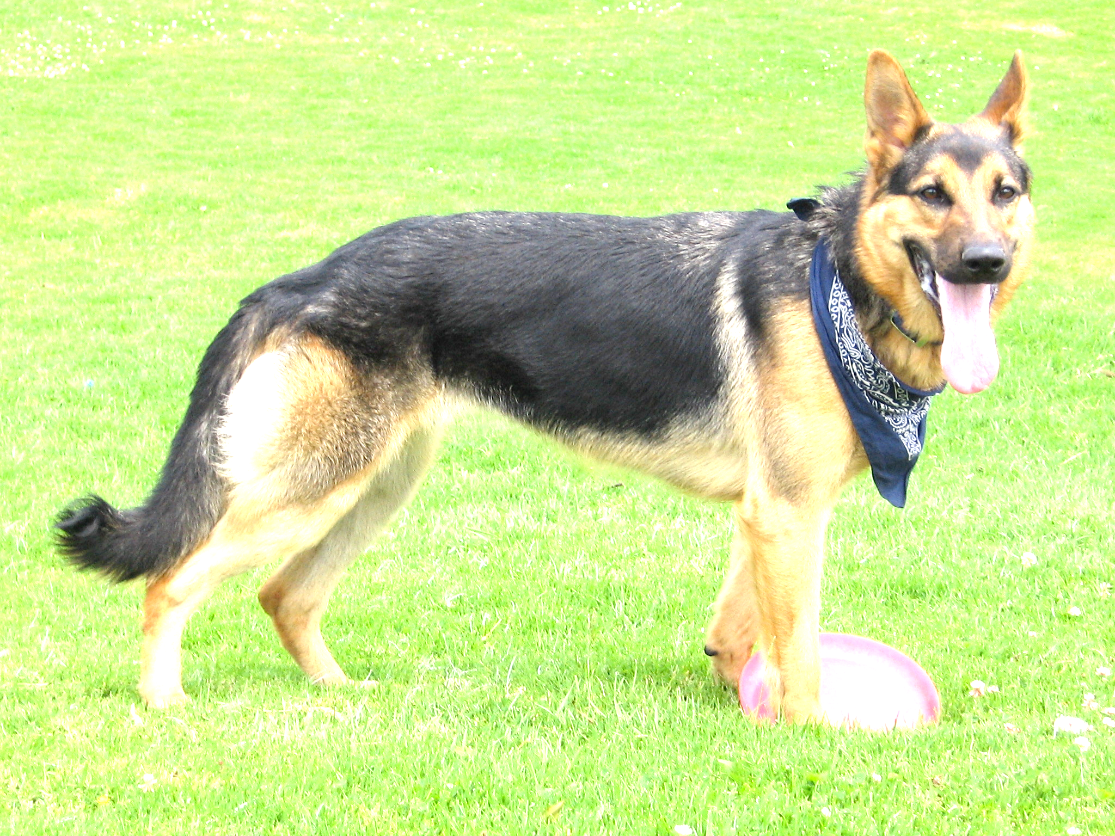
Invariances for Object Recognition Tasks
Viewpoint Invariance
$$=$$
$$=$$
Instance Invariance
Occlusion Invariance
Illumination Invariance

Slide 15
Measuring Invariances - Trajectories
Vary the transformation, keeping the other variables (category, illumination, etc) constant
Occlusion Trajectories created from the GOT-10K dataset

Slide 16
Measuring Invariances - Trajectories
A set of samples where the considered transformation varies,
keeping the other variables (category, illumination, etc) constant (approximately)
Occlusion Trajectories created from the GOT-10K dataset

Slide 17
Measuring Invariances - Trajectories
A set of samples where the considered transformation varies,
keeping the other variables (category, illumination, etc) constant (approximately)
Viewpoint+Instance Change Trajectories created from the Pascal3D dataset
Instance Change Trajectories created from the Pascal3D dataset

Slide 18
Measuring Invariances - Metric
For each neuron $h_{i}\left(x\right)$, the firing function is
$$f_{i}\left(x\right)=s_{i}h_{i}\left(x\right)>t_{i}$$
$$s_{i}∈\left\{−1, +1\right\}$$
For each neuron choose $s_{i}$ and $t_{i}$ such that $f_{i} = 1$for approximately $\frac{1}{\#classes}$ samples*
For a class y, the local firing rate of neuron $i$ is defined as:
Mean over samples of class y
Mean over trajectory
of the samples
For each class choose Top-K mean average $L_{y}\left(i\right)$ neurons, then compute mean over classes
*only for uniformly distributed datasets, check paper for a more general formulation

Slide 19
Occlusion and Viewpoint Invariance
Dataset | Method | Occlusion |  | Viewpoint |  | Instance
 |  | Top-10 | Top-25 | Top-10 | Top-25 | Top-10 | Top-25
Imagenet | Sup. R50 | 80.89 | 74.21 | 89.54 | 82.62 | 66.11 | 59.44
Imagenet | MOCOv2 | 84.19 | 77.88 | 85.15 | 75.08 | 62.49 | 55.01
Imagenet | PIRL | 84.46 | 78.38 | 85.8 | 76.08 | 52.97 | 46.79
MoCo has a relatively conservative cropping strategy compared to PIRL
Note that while ImageNet training also follows an aggressive cropping strategy, the objective doesn’t explicitly force the different samples to share the same representation
i.e. the representation could be distributed
ImageNet objective explicitly pulls together different viewpoints of the same category
ImageNet objective explicitly pulls together different instances of the same category
Checkout the paper for quantification of other invariances

Slide 20
Augmentations and Dataset Biases

Slide 21
Aggressive Augmentation
PIRL further divides these into 3x3 grids
Original Image
Possible Augmentation Outputs

Slide 22
Aggressive Augmentation
Why do these representations work for Object Recognition tasks?
Possible Augmentation Outputs

Slide 23
Aggressive Augmentation
Why do these representations work for Object Recognition tasks?
Training Dataset Bias
Capacity of the Neural Networks
Possible Augmentation Outputs

Slide 24
Training Dataset Bias
ImageNet Dogs
ImageNet Chairs
vs
ImageNet Tables

Slide 25
Diagnostic Experiments
MSCOCO follows a more natural distribution of images, so let’s train on that!

Slide 26
Diagnostic Experiment Results
Dataset | Method
ImageNet 10% | MOCOv2
MSCOCO | MOCOv2
MSCOCO Boxes | MOCOv2

Slide 27
Diagnostic Experiment Results
Confirmation of training dataset bias!
Dataset | Method | ImageNet
 |  | Top-1 Acc
ImageNet 10% | MOCOv2 | 38.53
MSCOCO | MOCOv2 | 33.64
MSCOCO Boxes | MOCOv2 | 34.24

Slide 28
Diagnostic Experiment Results
Confirmation of training dataset bias! What’s going on here?
Dataset | Method | ImageNet | Pascal
 |  | Top-1 Acc | Mean AP
ImageNet 10% | MOCOv2 | 38.53 | 62.32
MSCOCO | MOCOv2 | 33.64 | 64.39
MSCOCO Boxes | MOCOv2 | 34.24 | 59.6

Slide 29
Test Dataset Bias – Co-occurrence statistics
Example: Dining Table Images from MSCOCO
Also generally contain chairs!
Not distinguishing chairs and tables, doesn’t hurt on test-sets with similar co-occurrence statistics
About 50% of the table images in MSCOCO contain chairs

Slide 30
Diagnostic Experiment Results
Training dataset bias confirmed again!
Dataset | Method | ImageNet | Pascal | Pascal Cropped Boxes
 |  | Top-1 Acc | Mean AP | Mean AP
ImageNet 10% | MOCOv2 | 38.53 | 62.32 | 73.85
MSCOCO | MOCOv2 | 33.64 | 64.39 | 71.94
MSCOCO Boxes | MOCOv2 | 34.24 | 59.6 | 75.29

Slide 31
Diagnostic Experiment Results
Alternative theory: drop in performance could be the domain change i.e. full scene images are shown during training, but cropped boxes are used for testing.
In order to discredit this explanation, we create a separate test-dataset consisting of the subset of Pascal VOC07 test images which depict either table or chair in the image, but not both. We observe that on the table vs chair full image classification task, the representation trained on COCO-Boxes outperforms full COCO-image pre-training. Specifically, COCO-R50 has mAP of 73.64 and COCO-Boxes has mAP of 74.92

Slide 32
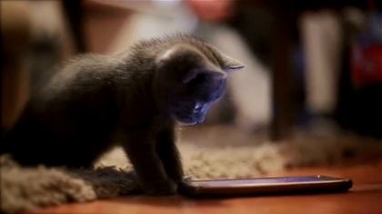
Learning from Videos

Slide 33
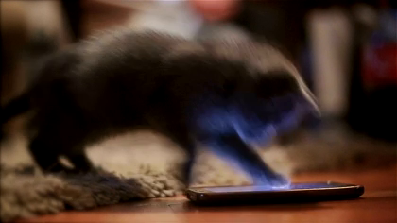
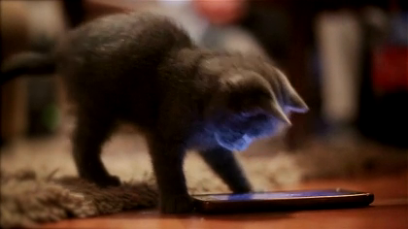
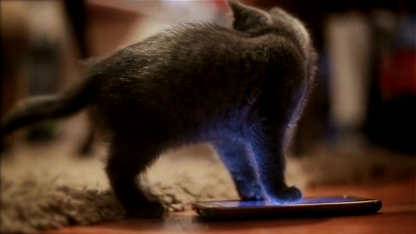
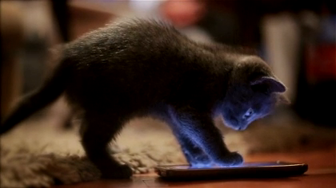
Learning from Videos

Slide 34
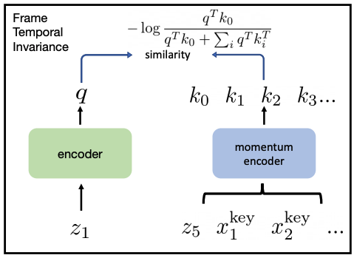
Learning from Videos

Slide 35
Learning from Videos
Track region proposals using an ImageNet based MoCo-v2 representation
$$z_{1}^{1}$$
$$z_{2}^{1}$$
$$z_{3}^{1}$$
$$z_{4}^{1}$$
$$z_{5}^{1}$$

Slide 36
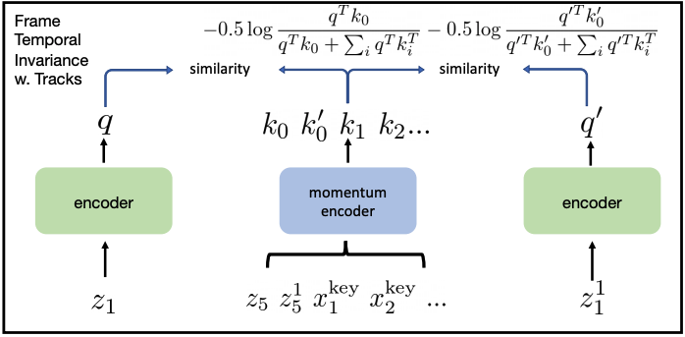
Learning from Videos
Track region proposals using an ImageNet based MoCo-v2 representation
$$z_{1}^{1}$$
$$z_{2}^{1}$$
$$z_{3}^{1}$$
$$z_{4}^{1}$$
$$z_{5}^{1}$$

Slide 37
Learning from Videos
MoCo-v2 trained on TrackingNet dataset
Dataset | Pascal | Pascal Cropped Boxes | ImageNet | ADE20K
 | Mean AP | Mean AP | Top-1 | Mean IOU | Pixel Acc.
Baseline MOCOv2 | 61.80 | 70.91 | 30.33 | 14.69 | 61.78
Frame Temp. Invariance | 63.89 | 72.17 | 29.34 | 14.41 | 61.85
Ground Truth Tracks | 66.21 | 76.16 | 37.45 | 14.69 | 61.78
Region Tracker | 66.47 | 75.86 | 36.51 | 15.28 | 63.29

Slide 38
Learning from Videos
MoCo-v2 trained on TrackingNet dataset
Method | Occlusion |  | Viewpoint |  | Instance
 | Top-10 | Top-25 | Top-10 | Top-25 | Top-10 | Top-25
Baseline MOCOv2 | 81.73 | 75.35 | 81.55 | 71.71 | 43.76 | 40.43
Frame Temp. Invariance | 79.92 | 73.33 | 83.87 | 74.86 | 42.98 | 39.42
Ground Truth Tracks | 81.52 | 74.6 | 84.82 | 75.3 | 47.51 | 42.93
Region Tracker | 83.26 | 76.52 | 84.97 | 76.18 | 48.81 | 44.38

Slide 39
Thank you!

